Slide 1
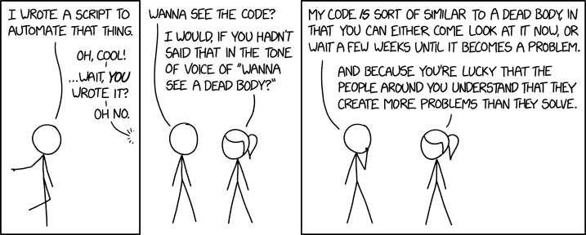
1.3:
If Statements and Coding Practices
ICS 3U/3C
David Beilby
Zeyad Nasr
Thomas Brittain

Slide 2
Pseudocode
A planning tool in coding
States the different objects, functions, and purposes in easy, understandable language: syntax doesn’t matter!
This is a great place to begin coding, so you know what you have to work on!

Slide 3
Flow Charts
Runs through the code in the input-process-output format.
Similar to pseudocode: shows the basic requirements of the code.
Visualizes the different steps that a code has to execute to function.

Slide 4
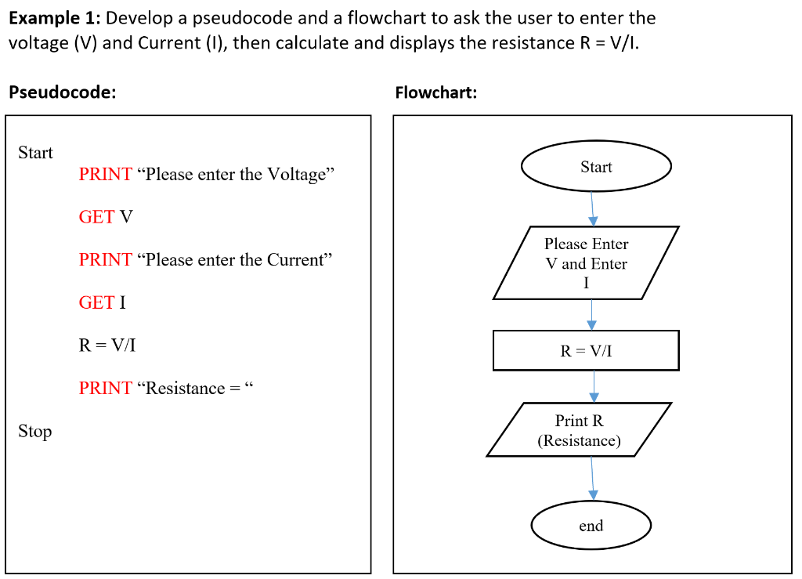
Examples

Slide 5
If Statements
If statements are used to make decisions in your code.
They use a variety of Boolean (logical) and comparison operators to accomplish this.

Slide 6
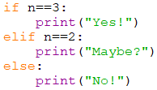
Basic Syntax
If → operand → colon
The indented code below the if statement will run if the condition is true.
Indent depth does not matter but must stay consistent!

Slide 7
Basic Syntax
Elif (else if) → Same syntax as If
Can only be placed below an if statement.
Will check another operand (condition) ONLY if the prior statements did not run.
Once a condition is met, the code underneath it is run, and the chain stops.

Slide 8
Basic Syntax
Else → no logic allowed!
Will run any code if no other IF or ELIF statements were true.

Slide 9
Operands: The Logic
Comparison Operators
Logical Operators
Operation | Result
== | Equal to
!= | Not equal to
> | Greater than
< | Less than
>= | Greater than or equal to
<= | Less than or equal to
Operation | Result
or | either condition is met
and | Both conditions are met
not | Neither conditions are met
Note:
Logical operators must be paired with comparison operators.

Slide 10
Challenge!
Ask the user to input a number. Print whether the number is smaller, greater than, or equal to 10.

Slide 11
Flow Chart!
Start
Print Greater than 10
Input User Value
Yes
Print Equal to 10
Finish
Check if the value is greater than 10
Yes
No
Check if the value is equal to 10
No
Print Less than 10

Slide 12
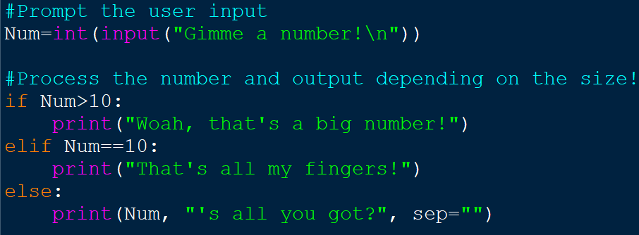
Example Code

Slide 13
Challenge!
Ask the user to input a number. Print whether the number is even or odd.

Slide 14
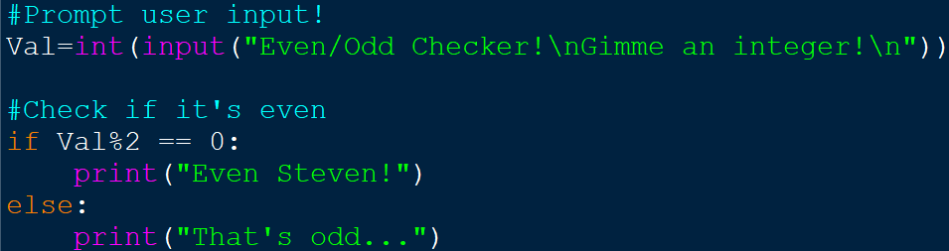
Example Code

Slide 15
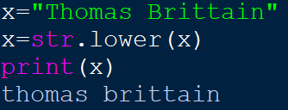
Don’t Make Python Mad
When you’re coding with if statements, you can compare strings, but they are case sensitive.
The str.lower() method returns a string as all lowercase letters.

